Slide 1

Info6150 final project presentation
HELPING HANDS
Noordeep Singh Gill - 002194664 - gill.no@northeastern.edu
Naman Gupta - 002142933 - gupta.nama@northeastern.edu
Kiran Unnikrishnan - 002101654 - unnikrishnan.ki@northeastern.edu
Siddhartha Savant - 001568075 - savant.si@northeastern.edu

Slide 2

INSPIRATION
When you give to Helping Hands you are funding life changing programs that help thousands of children's, adults and families to learn grow and thrive

Slide 3
purpose
Our application bridges the difference between the NGO and donors by creating a platform to aggregate all NGO where the NGO can raise requests for donation. The donors can view these requests and respond to them.
The donors can also schedule a visit to the NGO. The visit requests can then be approved or rejected by the NGO.
The website has a lot of features like creating user account, managing user account, NGO’s can raise request for donation, donors can donate and raise a request to visit the NGO, NGO can review visit requests.

Slide 4
Technology stack used
React for building the website
Bootstrap and SASS used for styling and making the application responsive
REST API to manage
mongoose to connect with MongoDB
bcrpyt to hash passwords.
nodemailer for account verification.
axios to send an HTTP request.
dotenv to store configuration.
Express, CORS

Slide 5
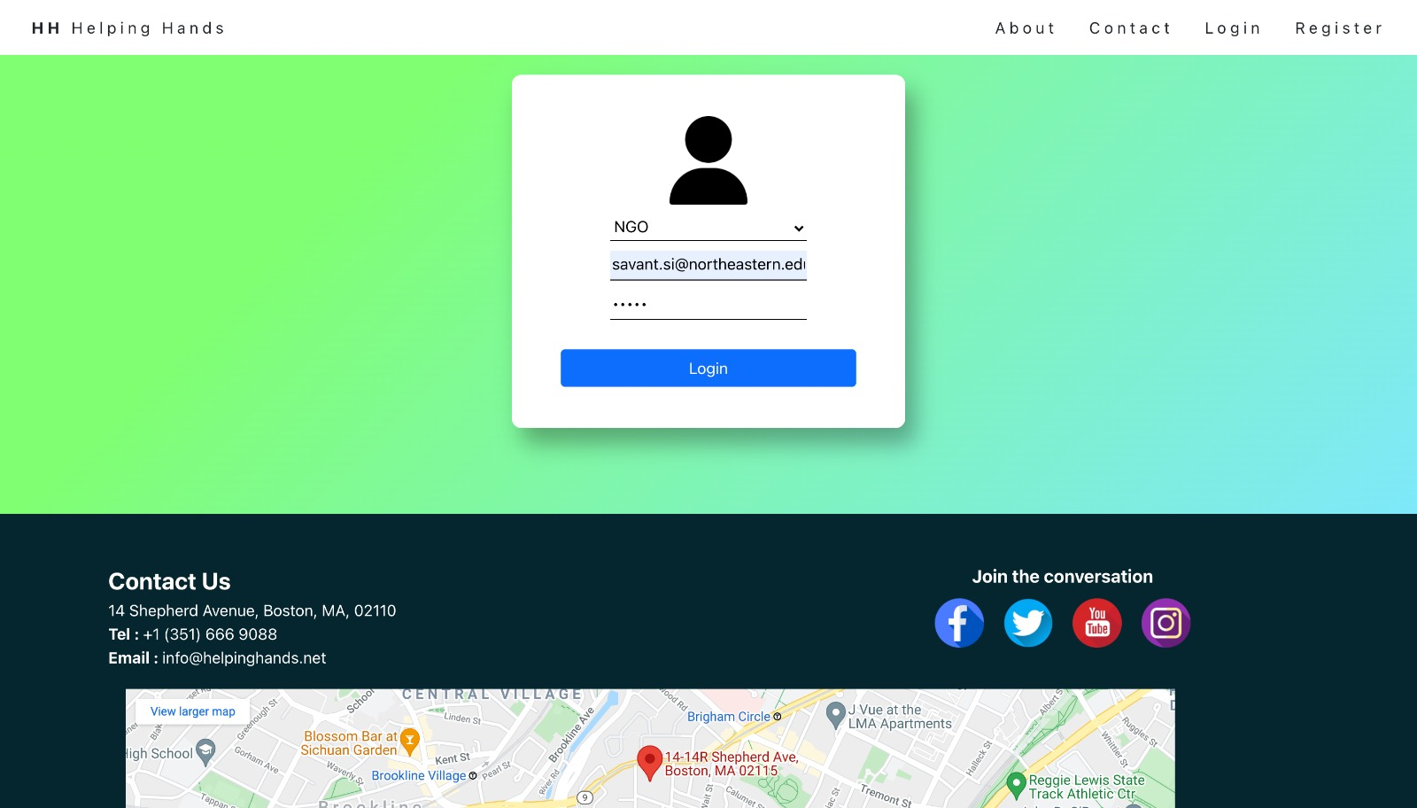

Slide 6
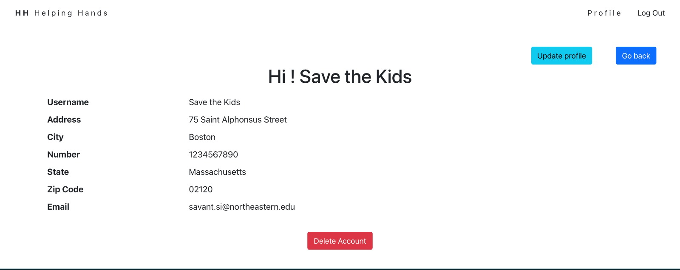

Slide 7
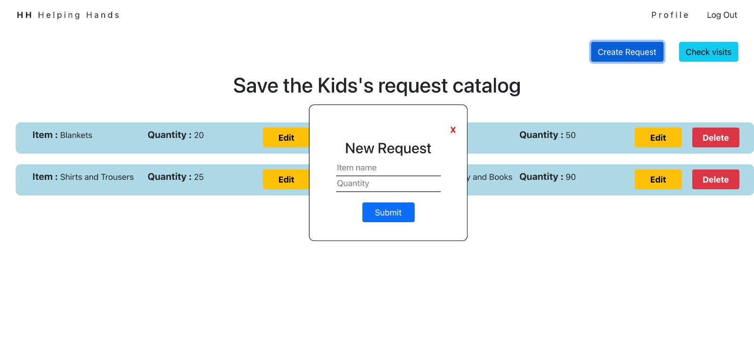

Slide 8
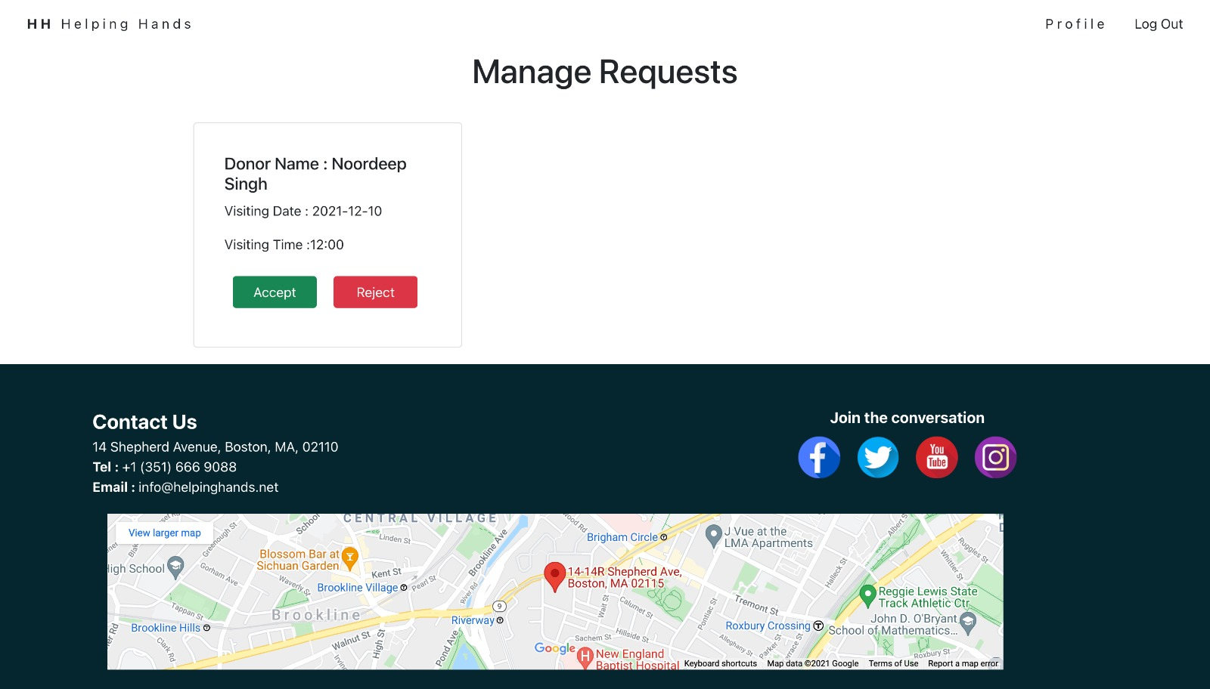

Slide 9
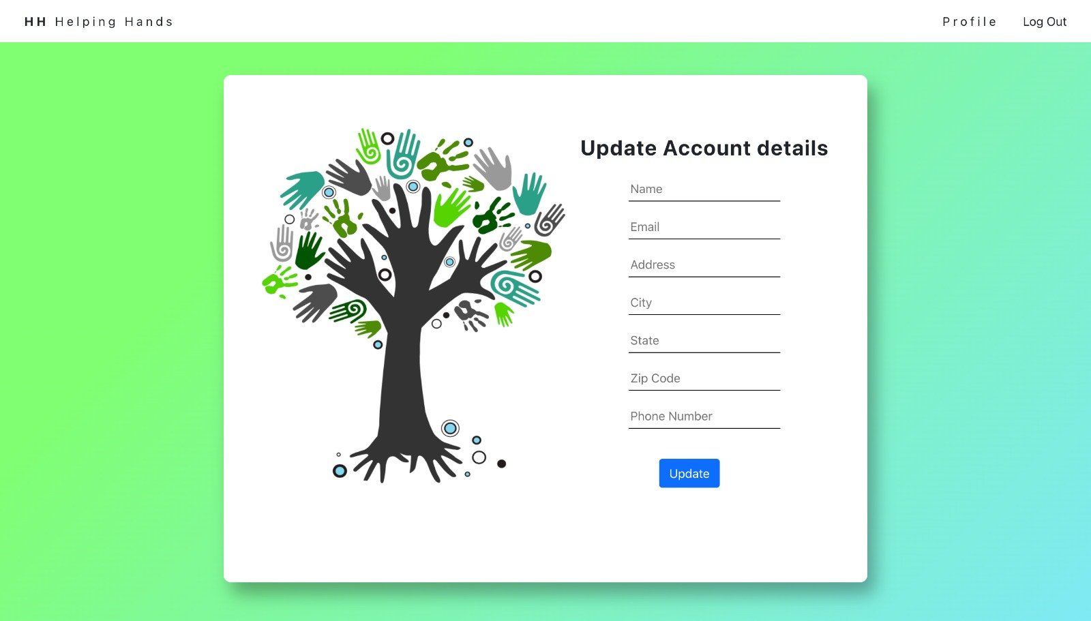

Slide 10
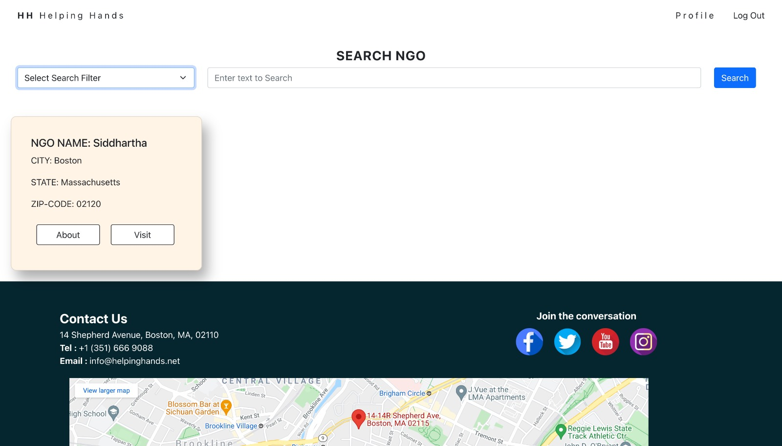

Slide 11
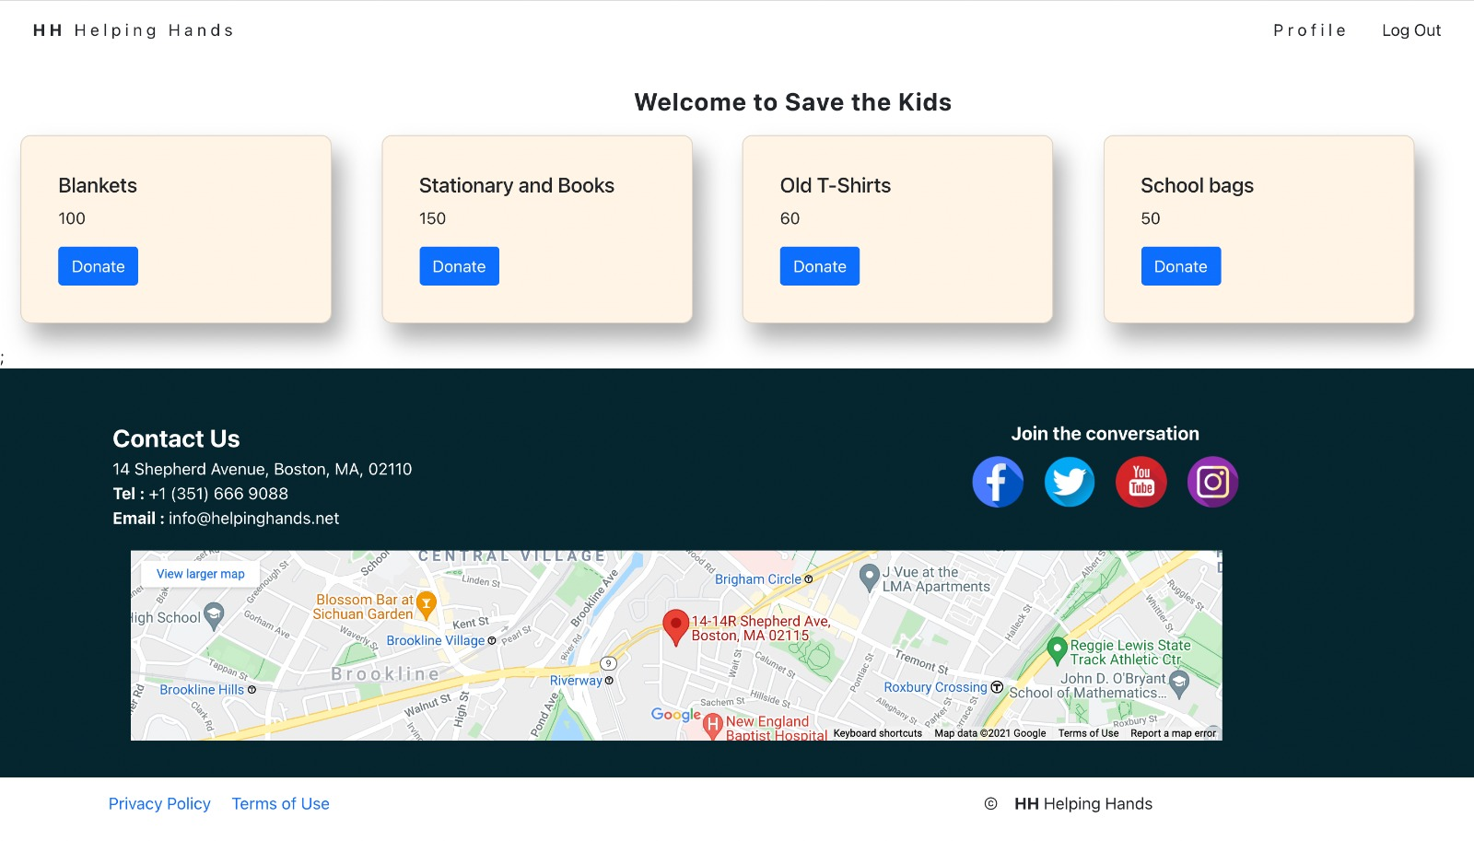

Slide 12
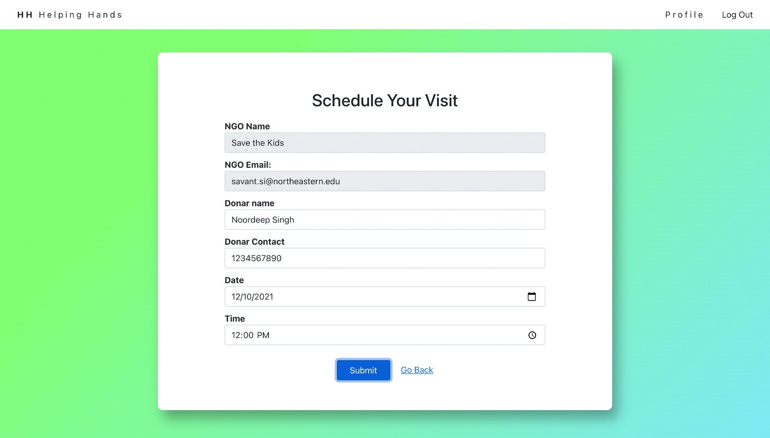

Slide 13
Team member contribution
Noordeep : Registration of Donor and NGO functionality completed,
Creation of NGO request, deletion of NGO request, updation of NGO request
Schedule visit to NGO functionality added, deactivation of User Account (NGO & Donor)
Contact US UI, Login page UI, Navbar UI, NGO UI, Update profile UI, footer UI, Contact Us footer UI
Kiran : Implemented the search bar component, Login Page UI, card layout component for displaying search results, implemented manage visits page for NGO , Creation of Donor visit request, deletion of Donor visit request, updation of Donor visit request, Created routing for HTTP calls from frontend
Siddhartha : Main page UI and Navbar functionality, Creation of Donor request, deletion and updation of Donor profile, Display and delete NGO requests, About Page UI, Used JWT token for token verification and Implemented Nodemailer for email verification, Created routing for HTTP calls from frontend
Naman : Worked on the backend of the application. Implemented JWT token, Password hashing, and authentication of user when he logs in, Checking if user already has account, Created routing for HTTP calls from frontend to backend, Added loader and error to display it on screen, Implemented Schedule visit page

Slide 14
THANK YOU

